Slide 1
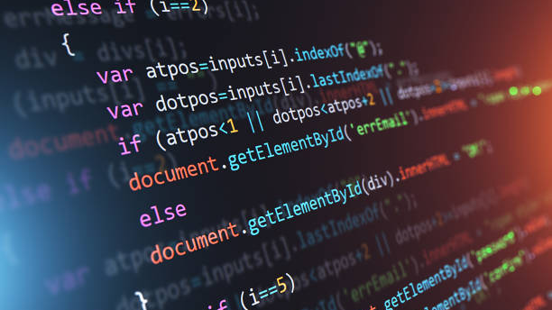
API
(Application Programming Interface)

Slide 2
Example
API as a Waiter in a Restaurant:
Imagine you’re at a restaurant. You don’t go into the kitchen to make your food; instead, you interact with the waiter.
Menu: The menu represents the API documentation, listing what’s available and how to request it.
Waiter: The waiter is like the API itself. You (the application) tell the waiter (the API) what you want from the menu.
Kitchen: The kitchen is the server or back-end system where the actual work is done.
Food: The food is the data or service you receive.
So, when you order from the waiter, you don’t need to know how the food is prepared or what ingredients are used. You need to know what to ask for (using the menu/API documentation), and the waiter (API) will handle the rest, bringing your food (data) from the kitchen (server).
This way, you get what you need without dealing with its complexities.

Slide 3
